Slide 1
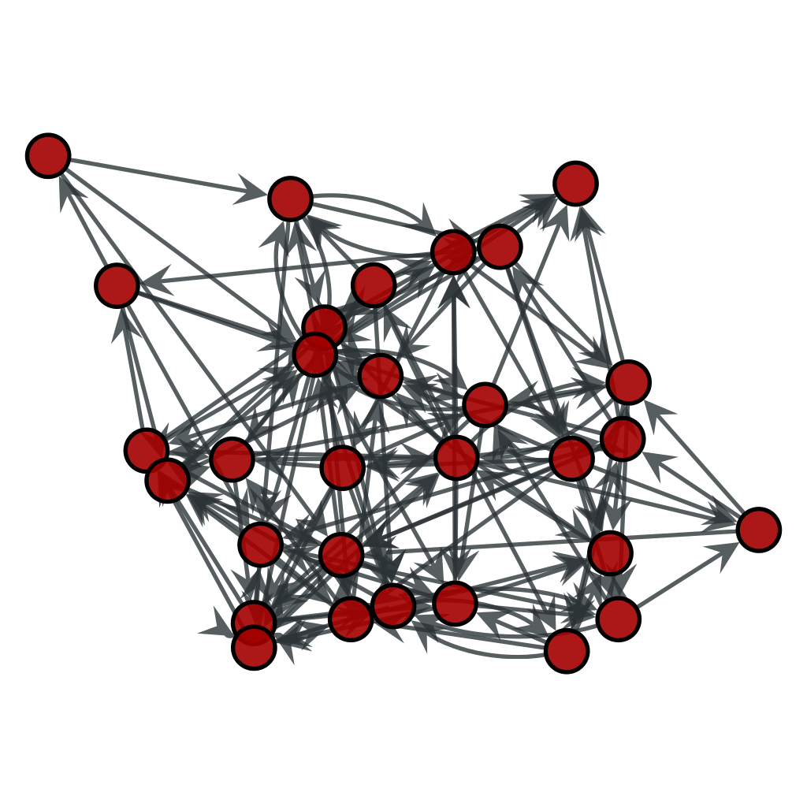
Truth Learning in Social and Adversarial Settings
By Amanda Wang, Julia Krizanova, Filip Uradnik, and Rhett Olson
Mentor: Professor Jie Gao

Slide 2
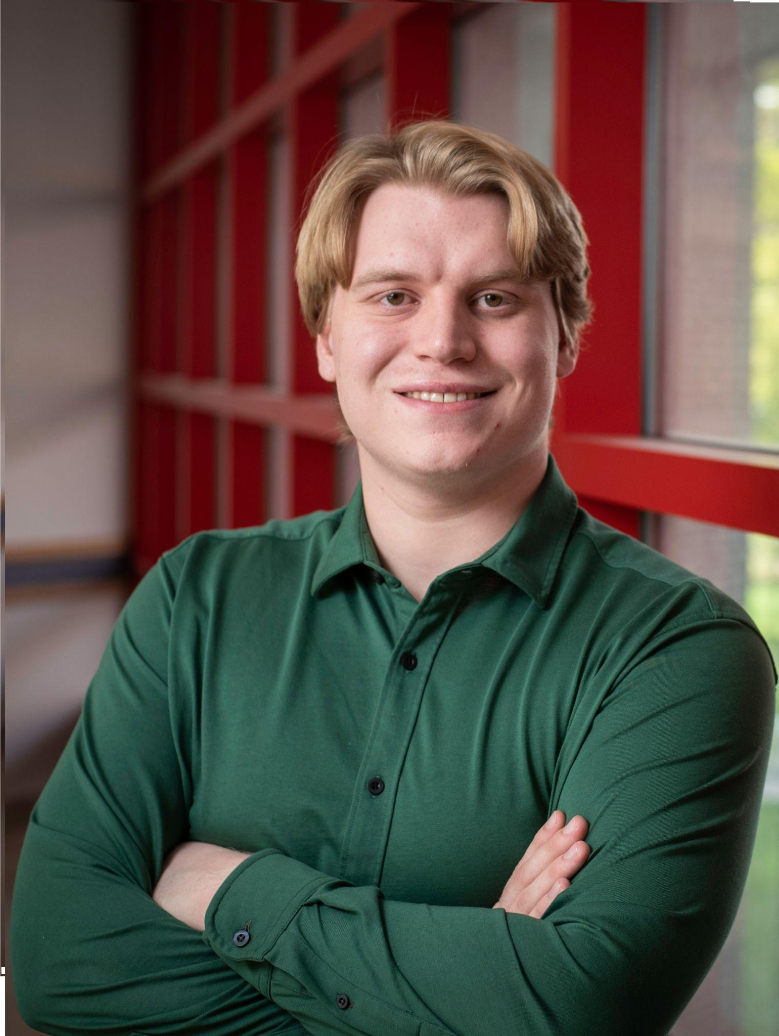
Truth Learning in Social and Adversarial Settings
By Amanda Wang, Julia Krizanova, Filip Uradnik, and Rhett Olson
Mentor: Professor Jie Gao
Notes:
We can use this version of the slide if we want to add our pictures and academic affiliations next to our names

Slide 3
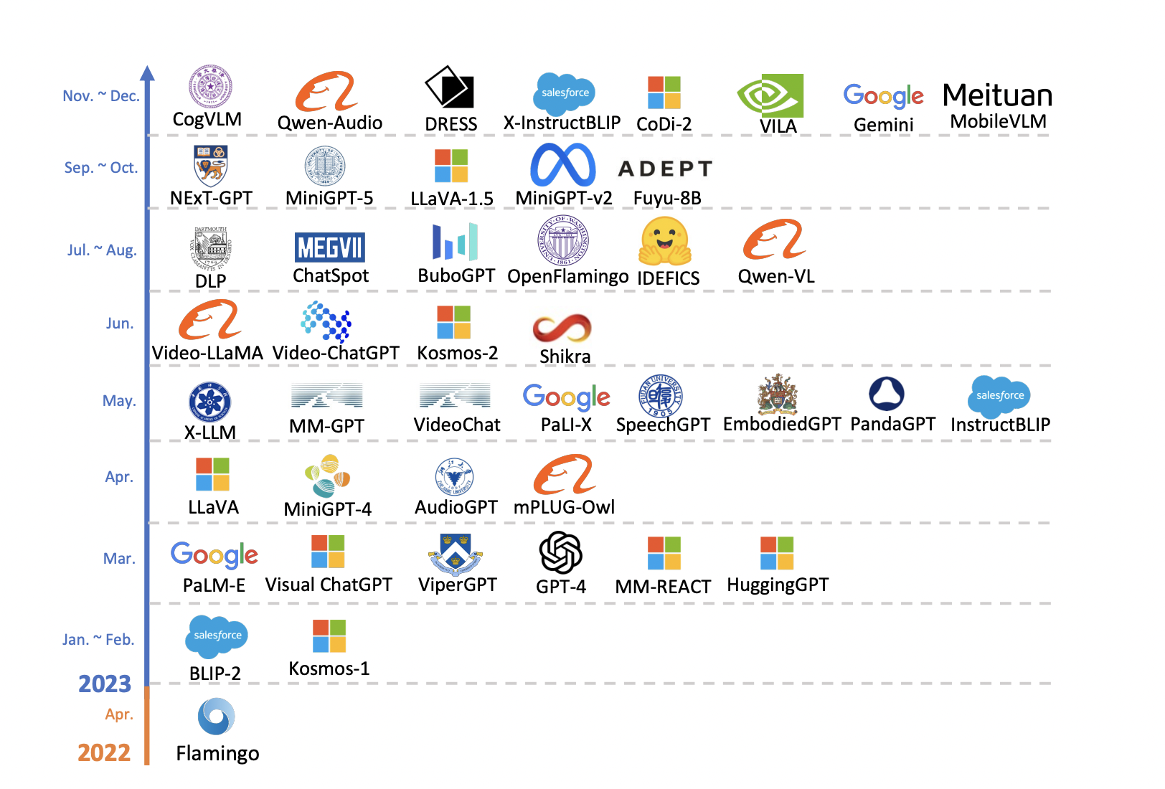
Motivation
Today’s social networks feature distributed + unreliable sources of information.
We often correct/reinforce beliefs by aggregating information from other sources with our own private information.
Examples: viewing the opinions of others on social media, aggregating the output of multiple AI models
Q: When is it possible for participants in a network to learn accurately?

Slide 4
Motivation
You have imperfect information about the world
You are influenced by other people, also with imperfect information
Examples:
Social media
Panel Discussions

Slide 5
Setup
Graph G(V,E) modelling n = |V| agents and network topology
Ground truth θ \in {0,1}
Agents make private noisy measurements of θ
Agents make predictions according to an ordering 𝜎, according to their private measurement + the predictions of neighbors earlier in 𝜎
Q: When is it possible for participants to learn a ground truth given a network topology, learning order, and distribution of private observations?

Slide 6
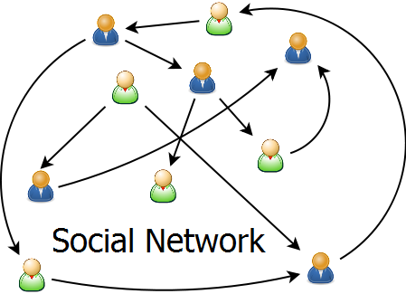
Setup
Social network structured as a graph.

Slide 7
Setup
Social network structured as a graph.
Vertices = agents.
Edges = which agents know each other.

Slide 8
Setup
Social network structured as a graph.
Vertices = agents.
Edges = which agents know each other.
Binary ground truth.

Slide 9
Setup
Social network structured as a graph.
Vertices = agents.
Edges = which agents know each other.
Binary ground truth.
Agents have independent, private, and noisy measurements of the ground truth.
Agents make predictions of ground truth sequentially.
based on private measurement & neighbors’ predictions.

Slide 10
Setup
Social network structured as a graph.
Vertices = agents.
Edges = which agents know each other.
Binary ground truth.
Agents have independent, private, and noisy measurements of the ground truth.
Agents make predictions of ground truth sequentially.
based on private measurement & neighbors’ predictions.
Q: When is it possible for agents to learn a ground truth given a network topology, prediction order, and distribution of private measurements?

Slide 11
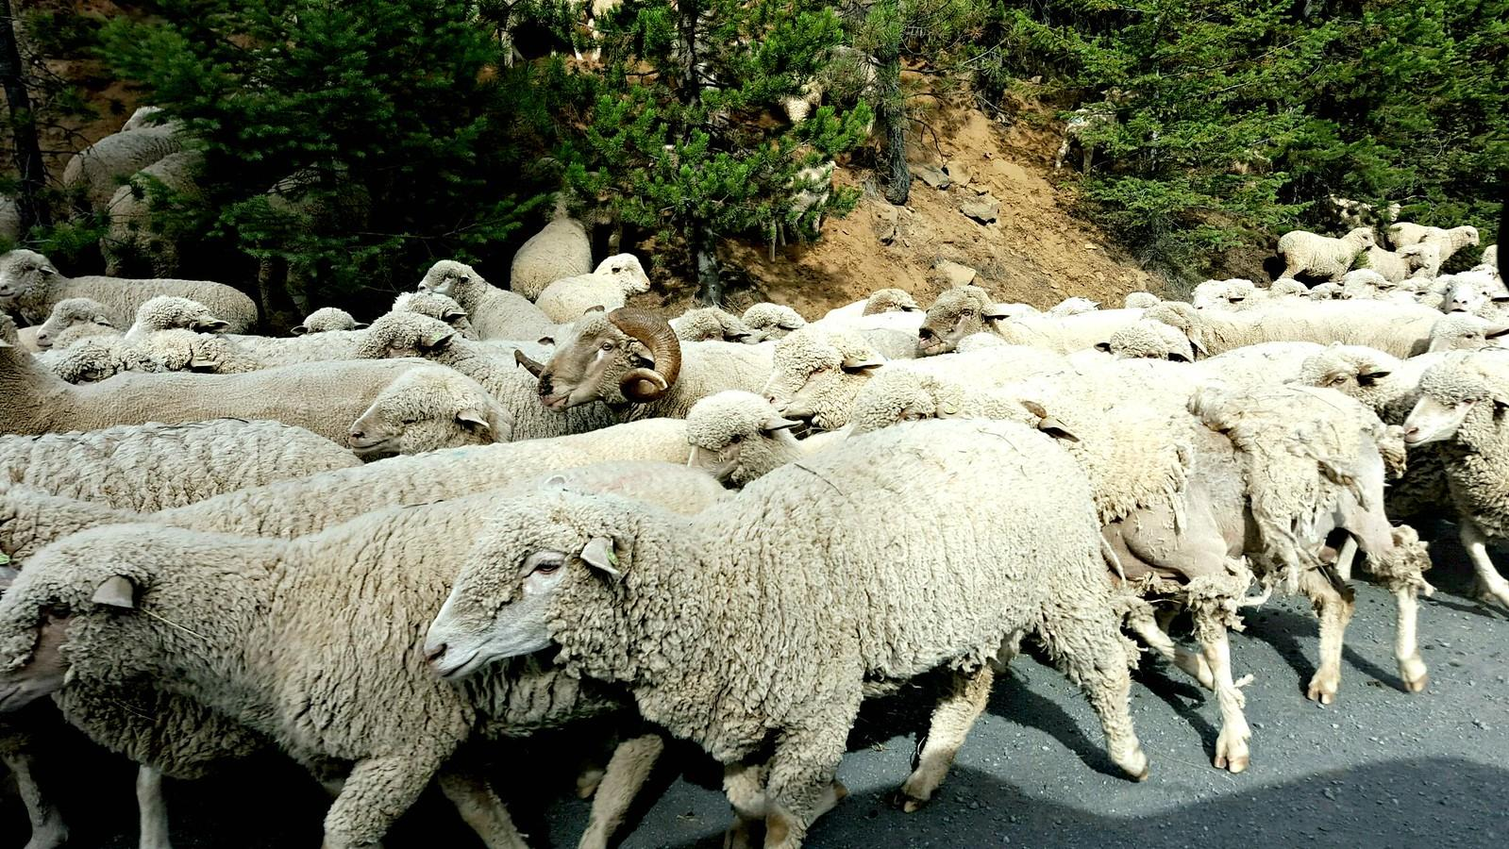
Information Cascades/Herding
Agents can become biased if one opinion appears to dominate among those it has seen.
Can lead nearly the entire group to stop using their own observations and instead copy previous decisions.
Notes:
Even in this basic vanilla setup, we can construct simple examples where most agents are unable to learn the ground truth with constant probability
can occur if the network is too dense (as we’ll see in the following example)

Slide 12
Cascade example
An urn contains either 1 blue + 2 red balls, or 1 red + 2 blue balls w/ equal probability.
Taking turns, each person:
randomly picks a ball to observe in private (with replacement)
publicly states if they think the urn is majority red or majority blue
?
Notes:
Specify that here the ground truth is binary and is “majority red” or “majority blue”
By “public announcement” we are implicitly specifying a complete graph, where agents see the predictions of all agents which are earlier in the decision ordering

Slide 13
Cascade example
Suppose 2 blue + 1 red.
Person 1 observes red. Announces “majority red”.
Person 2 observes red. Announces “majority red”.
3. Person 3 observes blue.
Announces “majority red”.
No new information!
4. Person 4 observes xx. Announces “majority red”.
…

Slide 14
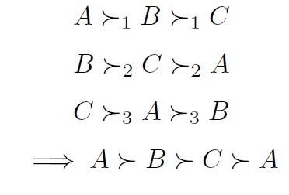
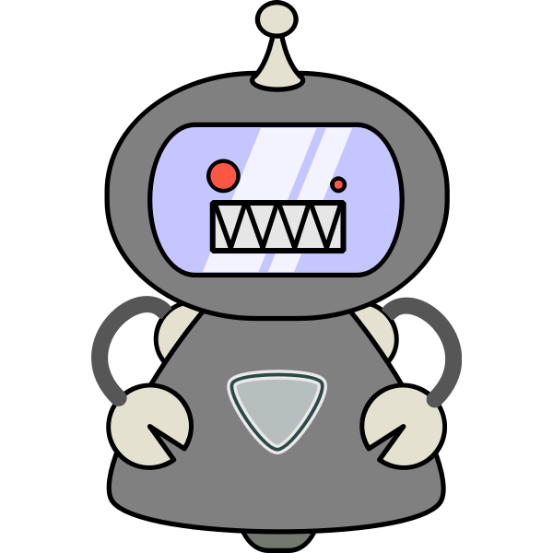
Directions
Complexity: Decide for a given network whether truth learning can happen.
Is this NP-hard?
Voting: Non-binary ground truth.
No “good” way of aggregating non-binary agent preferences.
Condorcet Paradox, Arrow’s Impossibility Theorem
Adversaries: How can adversarial agents affect the outcome?
How does this depend on the network structure?
How can the remaining agents protect against this?
Condorcet Paradox

Slide 15
Direction 1: Complexity
Decision Problem: Given a network topology, determine if there exists an ordering of agents which permits asymptotic learning.
Prove or disprove that this is NP-hard.

Slide 16
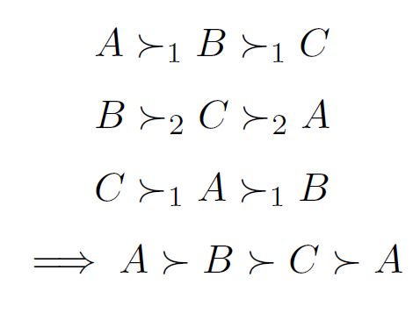
Direction 2: Ranking Alternatives as a Group
Existing work often considers binary decisions (e.g. approve or deny).
Extend this to choosing from several options.
Voting theory has shown many issues arise when trying to aggregate rankings of different agents into a single ranking.
Condorcet Paradox
Arrow’s Impossibility Theorem.
Condorcet Paradox: aggregating pairwise majority-vote rankings can break transitivity

Slide 17
Direction 3: Adversarial Agents
We cannot always assume that all agents are cooperative.
Example: bot accounts on social media spreading misinformation.
Need to prevent adversaries from herding the group towards a poor decision.
We examine how to aggregate information in a way that is robust against such adversaries.

Slide 18
Acknowledgements
This work made possible by the Rutgers DIMACS REU program. Thank you to faculty and staff who work to keep the program running. Thank you as well to the National Science Foundation for funding this project through the grant CNS-2150186 and the REU supplement to NSF 2208663 -Collaborative Research: AF: Small: Promoting Social Learning Amid Interference in the Age of Social Media.
This work was carried out while the authors Filip Uradnik and Julia Krizanova was a participant in the 2024 DIMACS REU program at Rutgers University, CNS-2150186. The authors were supported by CoSP, a project funded by European Union’s Horizon 2020 research and innovation programme, grant agreement No. 823748
Thank you as well to Professor Jie Gao for her help and leadership on this project.
Notes:
Lazaros sent an email about including acknowledgements for our presentations. Feel free to add anything I might have missed.

