Slide 1
Genomic Data-Guided Computational Modeling of Cancer Using NMF
DIMACS REU 2023
Elm Markert, mentored by Dr. Subhajyoti De

Slide 2
Introduction
Cancer is the second highest leading cause of death in the US
Earlier prediction can extend life expectancy
Recent advances in sequencing technology
Generation of more genetic data
Working with data from:
Bile Duct Cancer
Gastric Cancer
Ovarian Cancer

Slide 3
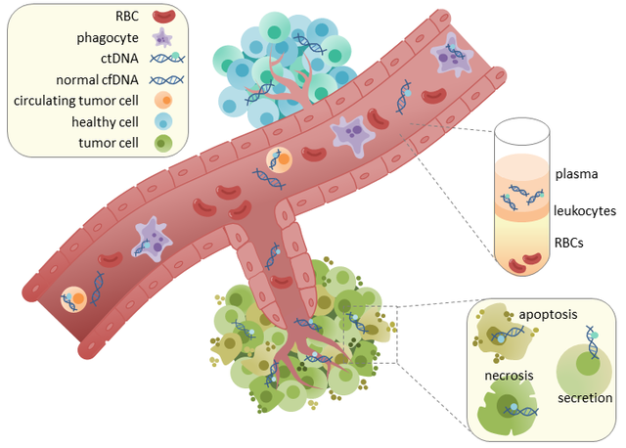
Cell Free DNA (cfDNA)
cfDNA is a form of degraded DNA fragment that enters the bloodstream after cell death.
Tumor cells also shed such DNA fragments in the bloodstream.
cfDNA degrades as it travels.
By nucleases, salt, etc
Rachel June Wong, 2017

Slide 4
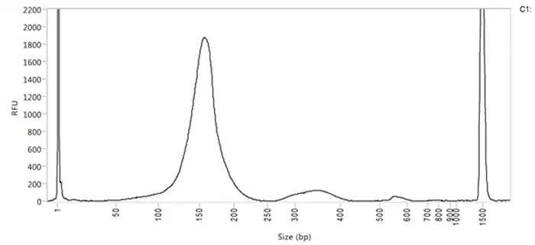
DNA Fragments
Degradation of cfDNA leads to fragments
cfDNA comes wrapped around nucleosomes at regular intervals
How does DNA fragment? What signals does that indicate?
Agilent, n.d.

Slide 5
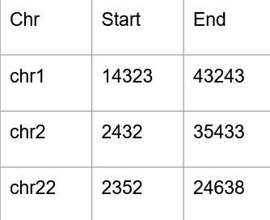
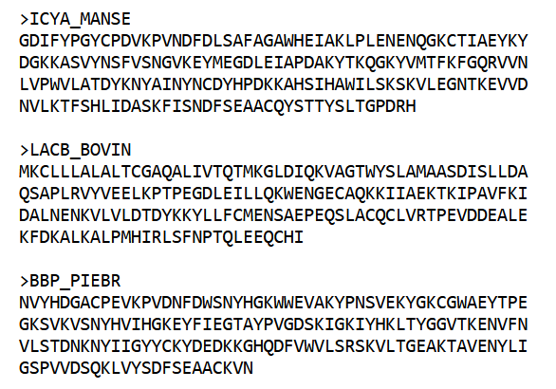
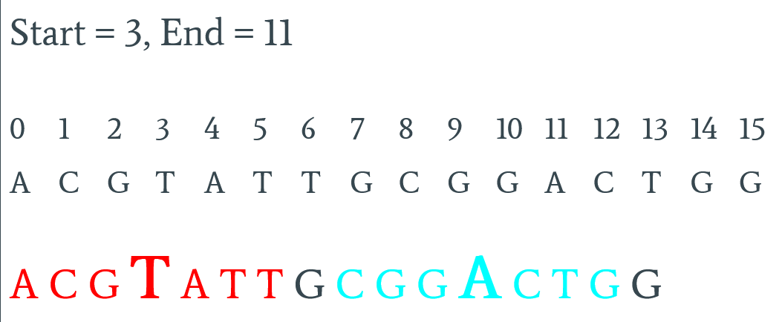
Data Summary
Start with .bed file and human genome .fasta file
Looking for start and
end +/- 3
MIT MEME Suite, n.d.

Slide 6
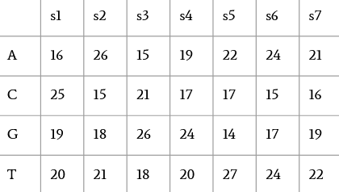
Data Summary (pt. 2)
End result: frequency tables
Separated into size groups
All
0-200 bp
200-600 bp
600+ bp
Eventually flattened into 1 long vector
Each vector is added to 1 big matrix

Slide 7
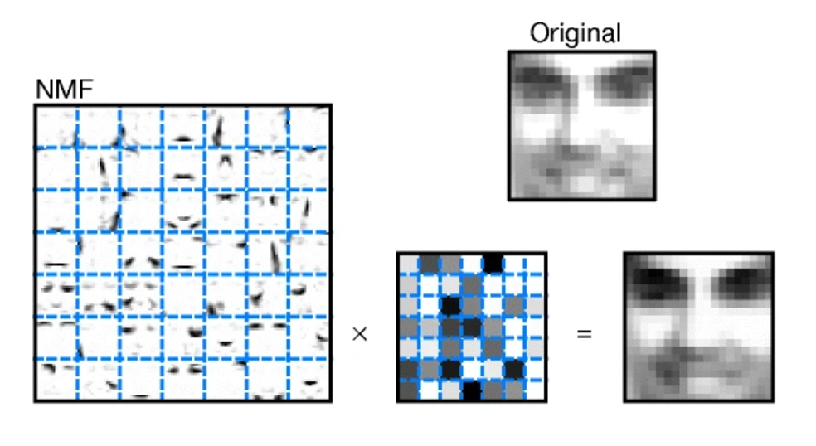
Non-negative Matrix Factorization (NMF)
A result matrix can be approximated by multiplying two other matrices together
Lee & Seung, 1999

Slide 8
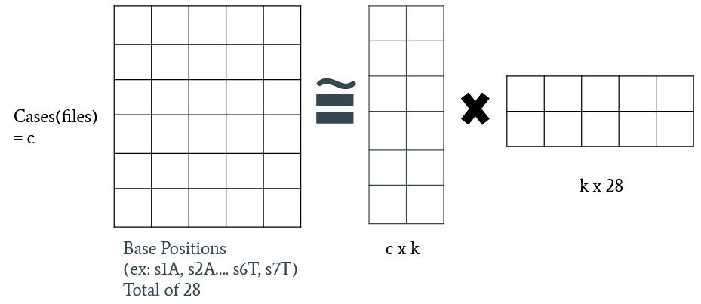
NMF (for this project)
k represents signatures that are degrading the DNA
Goal: reduce dimension and find important factors

Slide 9
NMF Results
Ranks differed depending on cancer type and fragment length
Generally 3-7, often on the lower end
3-7 factors (such as nucleases) that are degrading the fragments
No clustering based on fragment length or cancer type

Slide 10
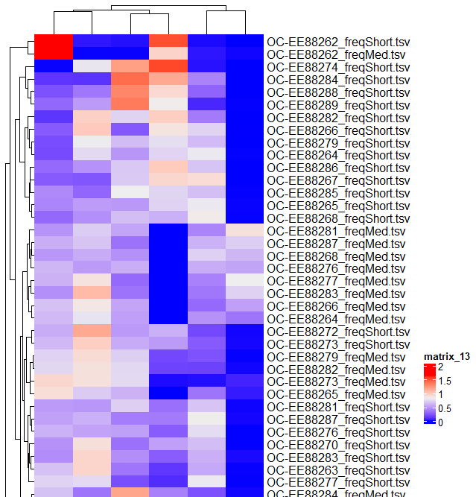
← Ovarian Cancer heat map with no clustering
Other cancers showed similar results

Slide 11
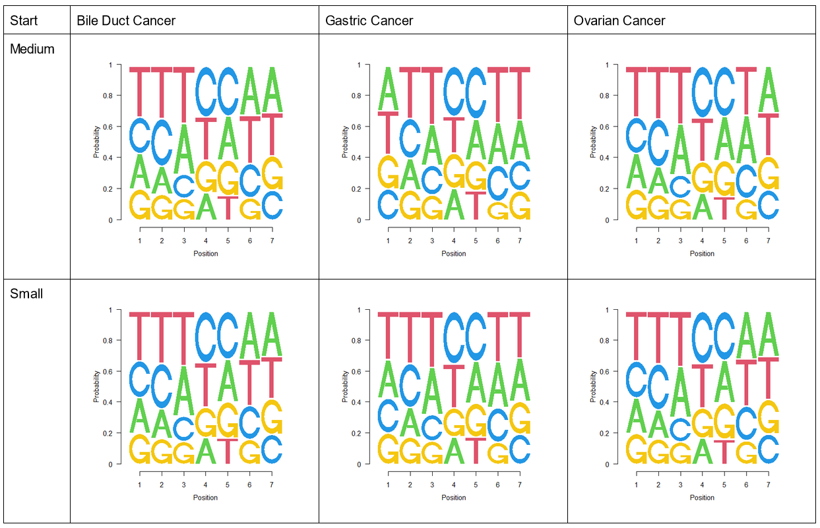
Results: Starting Sequence Logos
In position 4, the Gs in the medium fragments are slightly more frequent than the ones in the short fragments
Position 4 is the break point
Results at the end of the fragments were nearly identical

Slide 12
Summary and Conclusions
Differences in rank could indicate differences in how different types get degraded
No major differences between cancer types or fragment sizes in NMF
What factors do cause cases to cluster?
Is there a significance of the higher frequencies of G in medium fragments than small ones at the break points?

Slide 13
Future Work
Assess robustness of signatures in multiple cancers
Interpret results with biological knowledge about DNA nucleases
Overarching goal: Lab applications
Preserve genetic material more effectively
Pan-cancer screening tool

Slide 14
Acknowledgments
This work was completed at the 2023 DIMACS REU program
Thank you to everyone who helps keep the program running
The research was funded by the NSF through grant CNS-2150186
Thank you to Dr. Subhajyoti De for his mentorship
Thank you to Dr. Debajyoti Kabiraj, a postdoctoral associate in the De lab, for his additional help

Slide 15
References
Agilent. (n.d.). CfDNA Analysis – Quality Control Advantages with Agilent. Agilent. Retrieved July 19, 2023, from https://www.agilent.com/en/product/automated-electrophoresis/cfdna-analysis
De, S. (2021). Signatures Beyond Oncogenic Mutations in Cell-Free DNA Sequencing for Non-Invasive, Early Detection of Cancer. Frontiers in Genetics, 12. https://www.frontiersin.org/articles/10.3389/fgene.2021.759832
MIT MEME Suite. (n.d.). FASTA Format—MEME Suite. Retrieved July 19, 2023, from https://web.mit.edu/meme_v4.11.4/share/doc/fasta-format.html
Lee, D. D., & Seung, H. S. (1999). Learning the parts of objects by non-negative matrix factorization. Nature, 401(6755), Article 6755. https://doi.org/10.1038/44565
Rachel June Wong. (2017). CtDNA in circulation. Own work. https://commons.wikimedia.org/wiki/File:CtDNA_in_circulation.png

