Slide 1
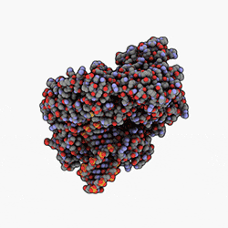
Demystifying Ribosomes
Uncovering the process of ribosome formation
Colton Fitzjarrald
Notes:
-read: titles

Slide 2
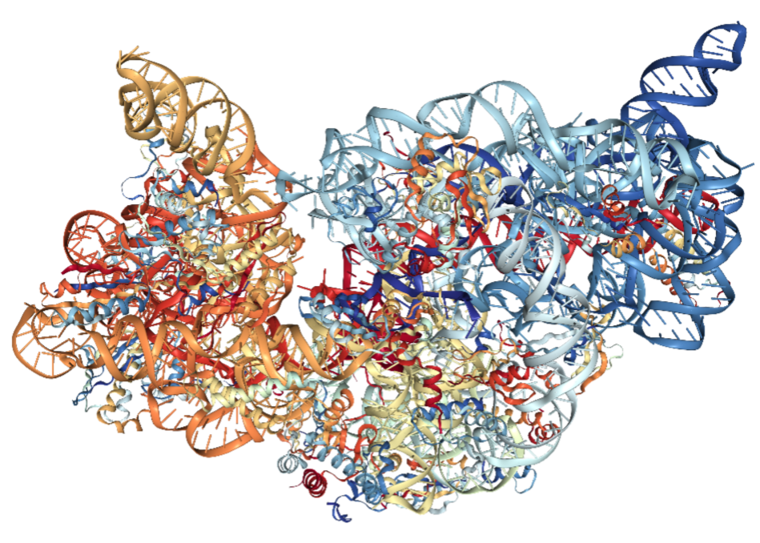
What is a ribosome: Structure
A ribosome consists of multiple long strands of RNA that are glued together by proteins.
DNA is the protein blueprint, RNA takes the blueprint and creates proteins.
Notes:
-so, what is a ribosome? What does its structure look like?
-A ribosome consists of multiple long strands of rna that are glued together by proteins. The picture on the right is a 3d representation of a ribosome.
-assuming you’ve all heard of dna, you can think of it like the architect with the blueprint for creating proteins. While dna remains safely inside the nucleus, rna takes that blueprint, leaves the cell, and manufactures new proteins according to those instructions.

Slide 3
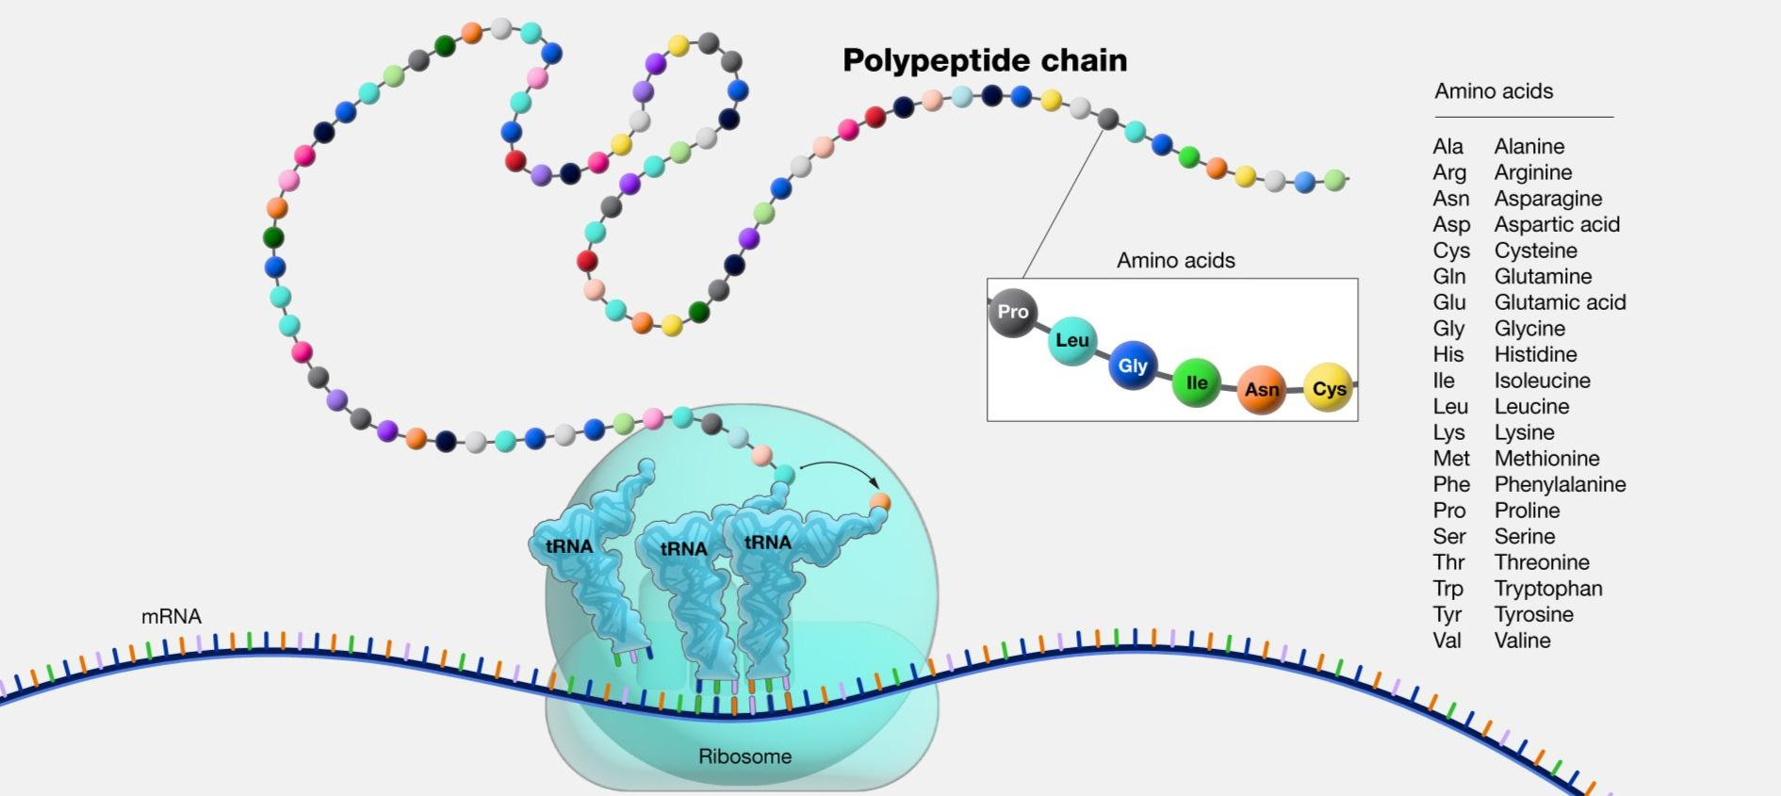
What is a ribosome: Function
A ribosome synthesizes proteins. In other words, it creates them.
Composed of amino-acids, proteins are the building blocks of life and are foundational to all living organisms.
Ribosomes piece together these amino-acids until they form a protein, then send it on its way.
Notes:
-what about the function of a ribosome?
-as i just mentioned, a ribosome is composed of strands of rna, and rna makes proteins, so what do you think a ribosome does?
It synthesizes proteins. It creates them.
-A little key information about proteins for those familiar with computer science. Proteins are essentially a linked list, with each node being an amino acid. And these proteins make up every living organism on earth.
-continuing with this analogy, a ribosome is nothing more than a biological algorithm that, using this blueprint that it got from dna, continually connects those amino acid nodes until it reaches the specified length, and it terminates. Sending the protein away.

Slide 4
What we want to understand about the ribosome:
How does the ribosome form?
Notes:
-so, what do we want to understand about the ribosome?
-what we want to know is how we go from this, to this.
-How do we get from these few strands of rna, to this complicated structure on the right?
-how does the ribosome form? That’s what we wish to understand.

Slide 5
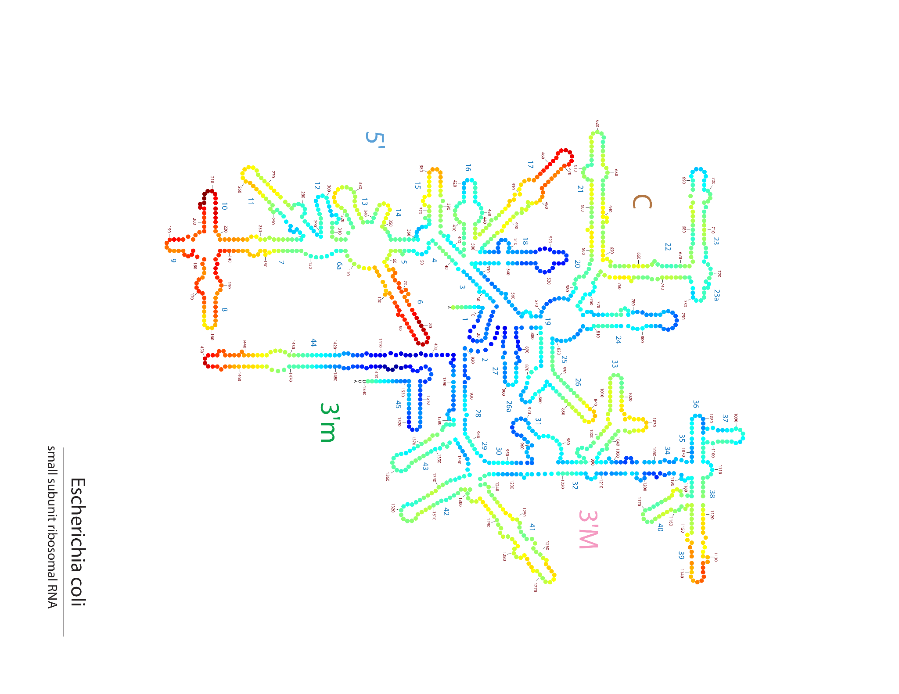
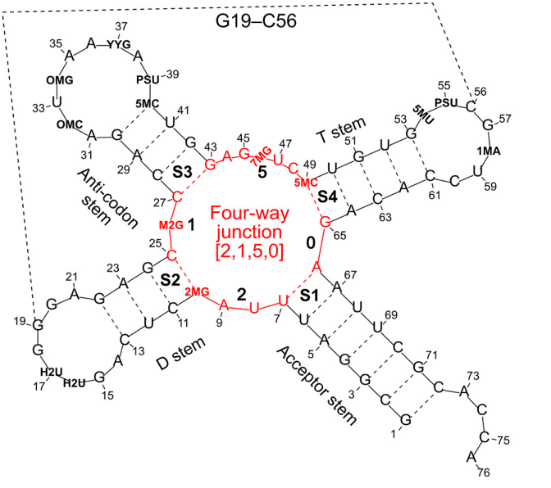
What research has been done already?
Non-matrix representations
Representations via various 2-D projections and maps of ribosomes and RNA.
Notes:
-You might be wondering, what sort of research has been done in this area already.
-for the most part, research has focused on creating representations of the ribosome and similar structures. By abstracting the fine details of the 3-dimensional structures, we can look at what’s happening from different perspectives.
-One perspective that’s particularly difficult to see from these 2-D projections i have up here, is the actual 3-d shape of the structure. And to point this out, looking at this dotted line connecting both sides of this small rna strand…that dotted line is supposed to indicate that those two amino acids are near each other.
-We need a way to represent the ribosome where we can analyze from various perspectives, without compromising the intuitiveness of the map.
-you’ll notice on this slide i put “non-matrix representations”, and that is because as far as we know, there have been no matrix representations of a fully sequenced ribosome.

Slide 6
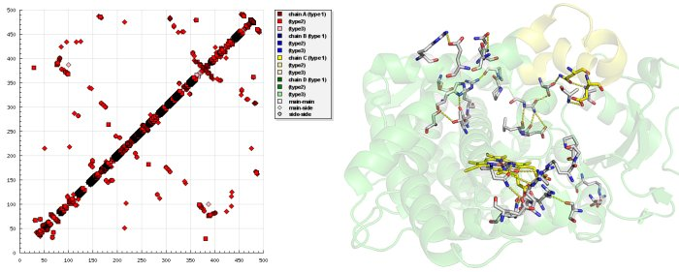
What our research will be:
Using newly sequenced ribosome data from this year, we will create matrix representations at different stages of the life cycle of ribosomes.
What exactly does a matrix representation of a complex biochemical structure consist of?
Distances between amino-acid residues(protein contact map)
Base pair configuration
Notes:
-what our research will be
-Using newly sequenced ribosome data from this year, we will create matrix representations at different stages of the life cycle of ribosomes.
-and so, what exactly does the matrix representation of a ribosome consist of?
-there are two different measures which we intend to investigate first.
-one is the distances between the amino acid residues, often referred to as a protein contact map. This is where we systematically measure the relative distances between amino acids in the structure, then we plot that into a graph.
i have one example here, notice how some red dots tend to cluster and some do not. This plot will change as the structure progresses.
-our second measure is to look at base pair configurations. Following along the sequence of amino acids in the rna strands, we can plot there relative positions as well, also creating a contact map similar to the one above.

Slide 7
Summary
Using various matrix representation methods, we will take “snapshots” of a series of ribosomes over their lifespans.
Creating a biochemical photo album of the ribosome, with each picture taken from many perspectives (representation type), and across its entire life.
Notes:
-To sum everything up, our intent, by using different matrix representation methods, is to create snapshots of a series of ribosomes over their respective lifespans.
-this will create a sort of photo album for each ribosome, and each picture in the photo albums will be from different perspectives, so as to see things the scientific might not have noticed before.

Slide 8
Acknowledgements:
This presentation was a part of the 2023 DIMACS REU program at Rutgers University, supported by NSF grant CNS-2150186
Images sourced from articles written by Dr. loren Williams from Georgia Tech, and Dr. Xiang-Jun Lu at Columbia University
Information sourced from the aforementioned writers, the National Human Genome Research Institute, and the RCSB Protein Data Bank

